Slide 1

ICT Learning Centre @ UL - Python and ML Foundations
Python – Introduction & IDE

Slide 2



Introduction to Python
A high-level, versatile programming language

Slide 3


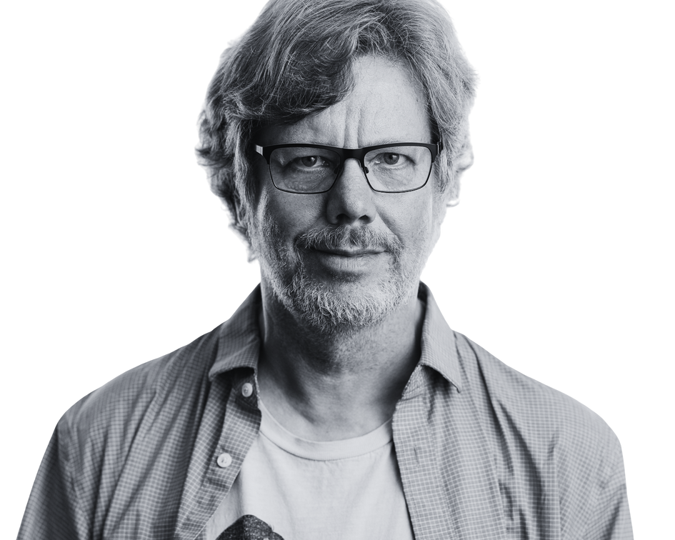

What is Python?
# sample Python Code
favourite_colours = [‘red’, ‘green’]
colour = ‘blue’
High-level
Versatile
Intuitive syntax
if colour not in colours:
favourite_colours.append(colour)
Fun fact:
Named after Guido Van Rossum’s favourite British comedy troupe, Monty Python’s Flying Circus!

Slide 4
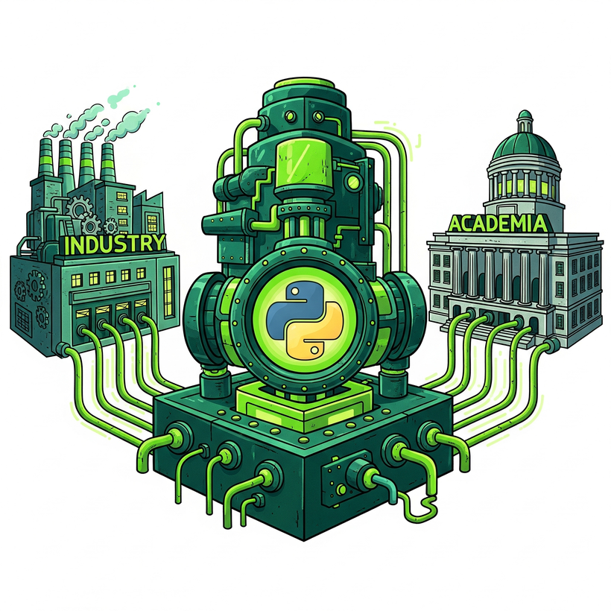
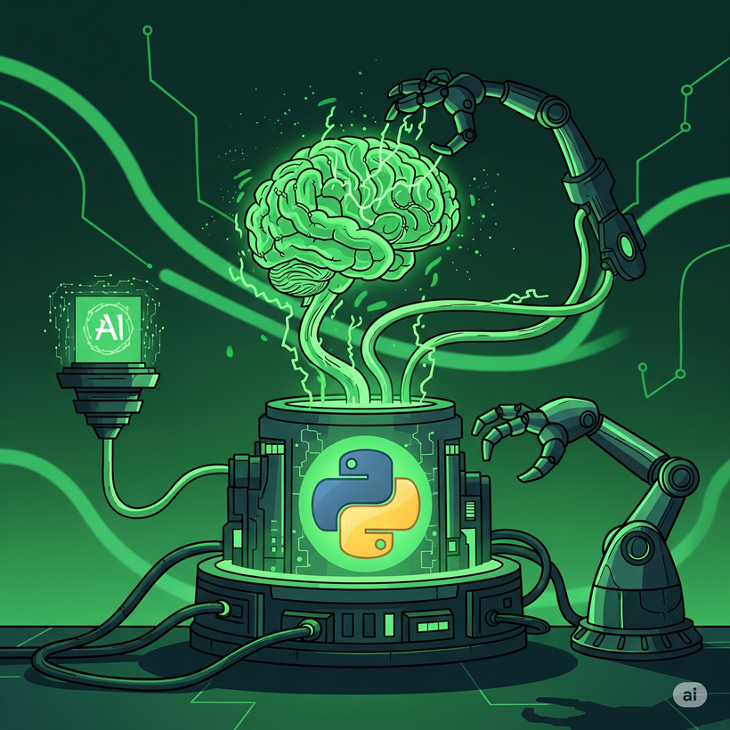



Why Python?
Dominant in industry and academia
Language of choice for AI & ML
Versatile and easy to learn
Powerful libraries and ecosystem

Slide 5

IDE –
Google Colab
Your python workspace

Slide 6


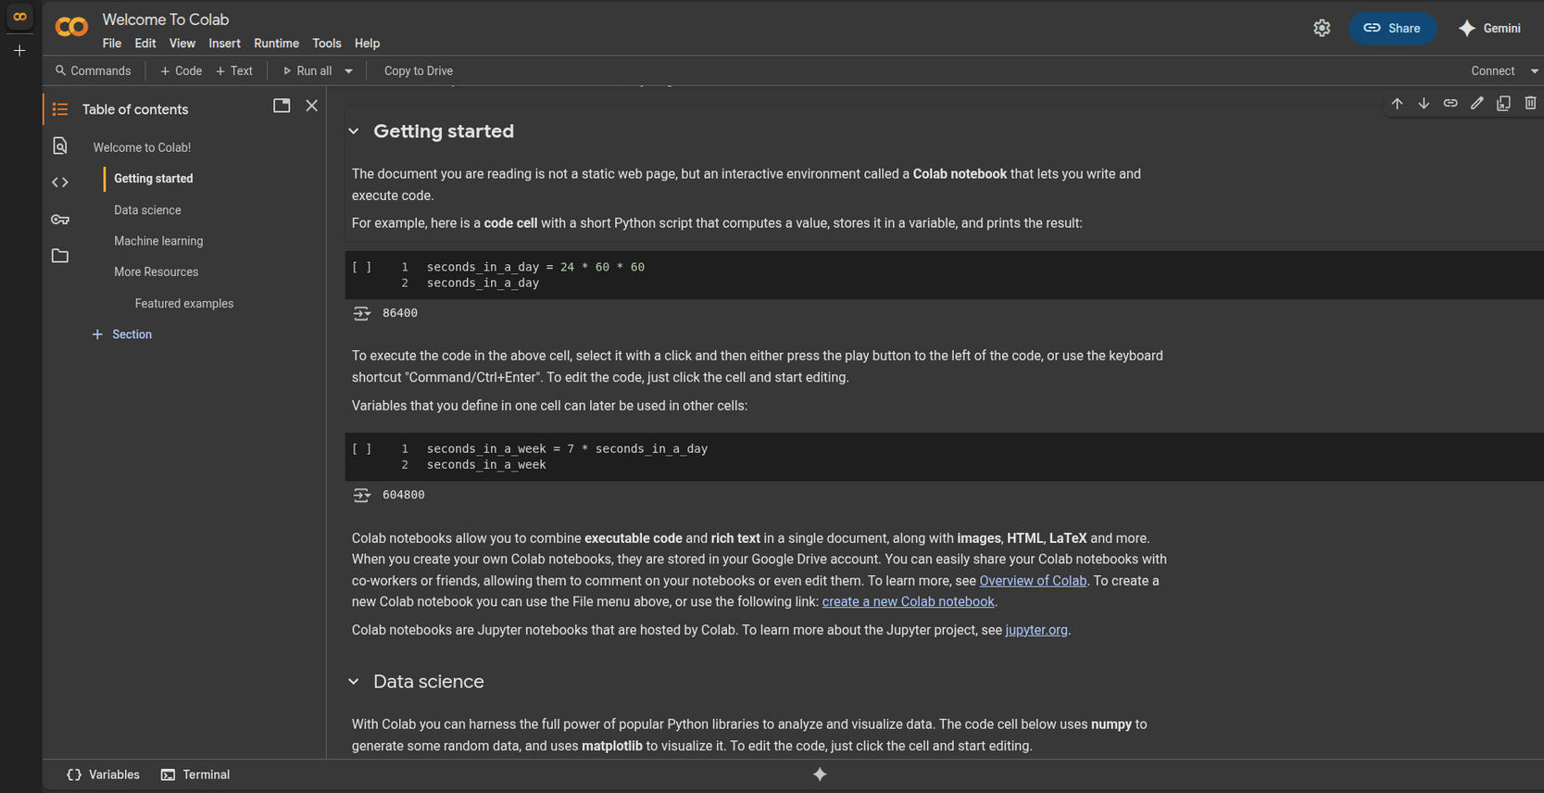
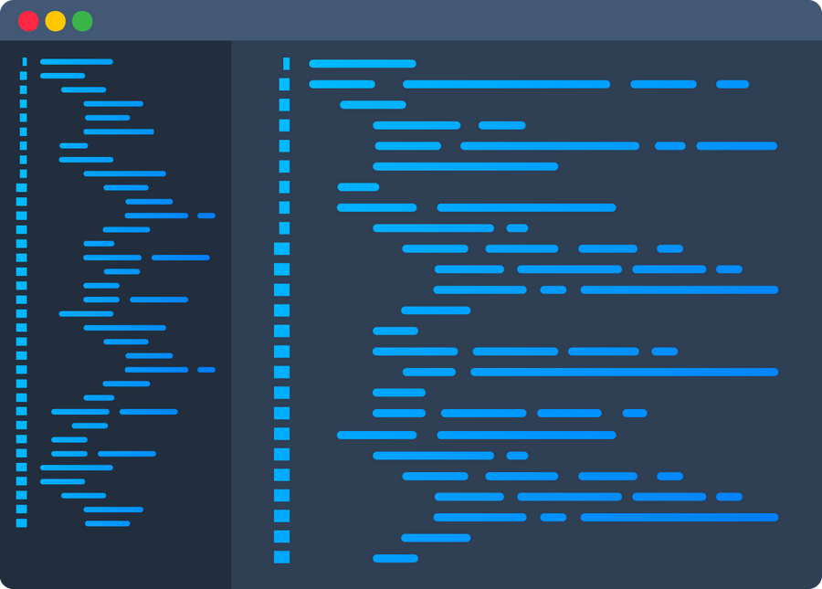
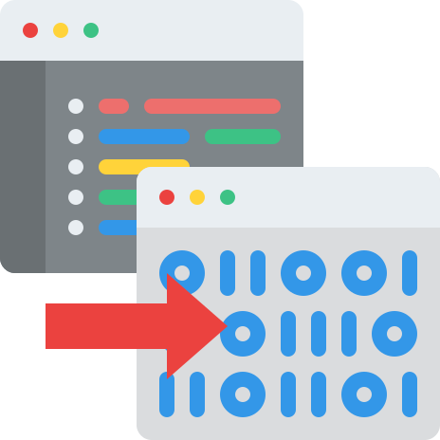
What is an IDE?
Integrated Development Environment
A programmer’s workshop

Slide 7
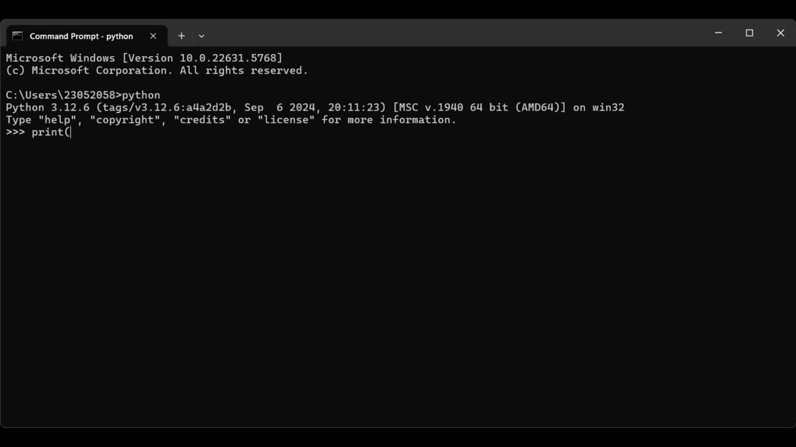

Slide 19
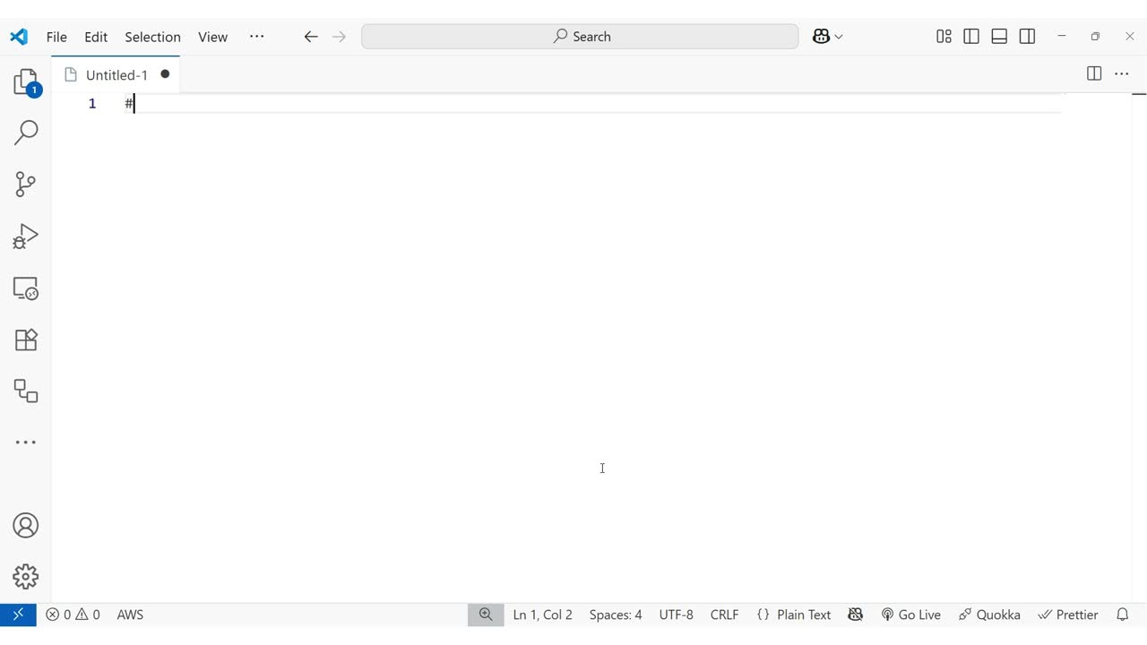

Slide 25
NOT AN IDE!!!

Slide 26
NOT AN IDE!!!

Slide 29
*Press Ctrl + J to open terminal in VS Code

Slide 33
Google Colab(oratory)
No local installation required
Only need web browser + Google account
Easy collaboration
Access to powerful cloud hardware (GPUs)

Slide 34
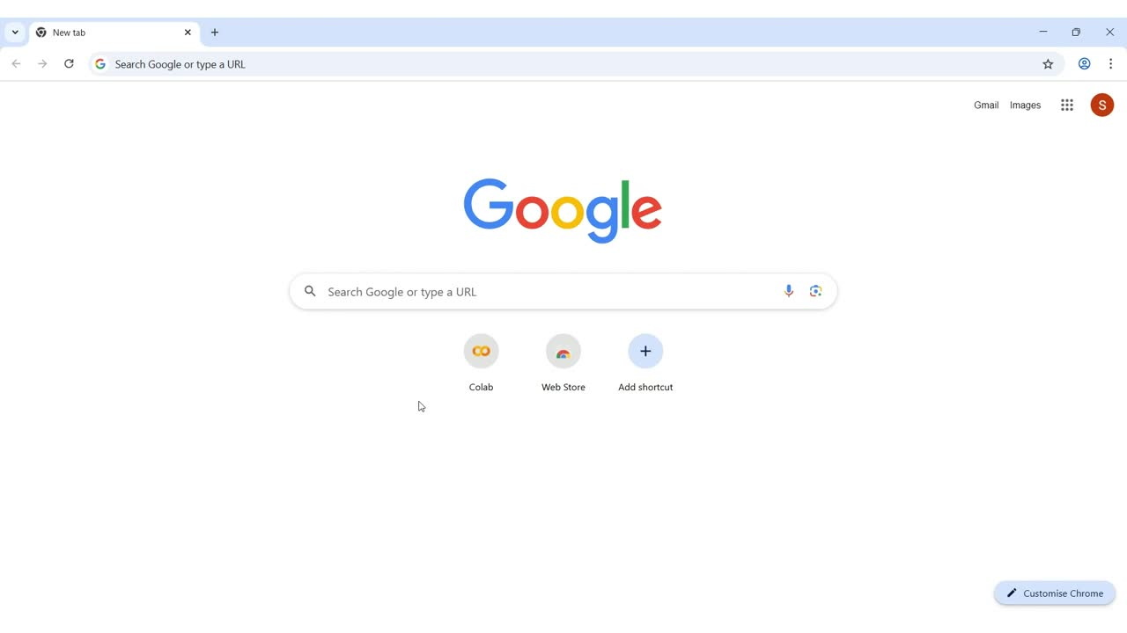

Slide 37

Project Jupyter

Slide 41
Code Cell
Text/Markdown Cell

Slide 42
Ctrl + Enter

Slide 44
print(‘Prints string as output’)
Datatype: String

Slide 50
https://www.markdownguide.org/cheat-sheet/

Slide 53

ICT Learning Centre,
CS1-046,
CSIS Building,
University of Limerick,
http://ictlc.ul.ie/contactus
Thank you

